Slide 1
Greek
Influence
Government
Where?
Yes or No?
True/False
100
100
100
100
100
200
200
200
200
200
300
300
300
300
300
400
400
400
400
400
500
500
500
500
500

Slide 2
Which of the following ideas did the United States use as a basis for the government?
Monarchy
Democracy
Aristocracy

Slide 3
Democracy

Slide 4
What form of Greek architecture is used in many of the buildings in the U.S.?
Columns
Decks
Slanted Roofs

Slide 5
a. Columns

Slide 6
Which of the following occurs every four years, is participated in by athletes from the U.S., and originated in the country of Greece?
A. The Superbowl
B. The Daytona 500
C. The Olympic Games

Slide 7
C. The Olympic Games

Slide 8
The White House has examples of Greek influence on the front. What is the name for these fixtures?
A. Railings
B. Columns
C. Stairs

Slide 9
B. Columns

Slide 10
Jamie is an expert runner in the track and field events in his school. Which Greek occurrence might be a goal for him in the future?
A. Column Builder
B. Democratic Candidate
C. Olympic Contender

Slide 11
C. Olympic Contender

Slide 12
A democracy is a government that is formed for the people, ________________________.
Fill in the blank

Slide 13
By the People

Slide 14
In a democratic government, leaders are chosen in which way?
A. They are elected by the people.
B. They are chosen based on their parents.
C. They pay money to get the job.

Slide 15
A. They are elected by the people.

Slide 16

Which of the following is elected by voters to govern a single state?
A. Mayor
B. President
C. Governor
.

Slide 17
C. Governor

Slide 18
In Greece, only men who were property owners were allowed to vote for their leaders. How is the U.S. different?
A. Only men over 35 can vote.
B. White men can vote.
C. Men and women who are legal citizens can vote.

Slide 19
C. Men and women who are legal citizens can vote.

Slide 20
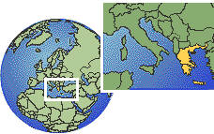
Which continent is the country of Greece located on?
A. North America
B. Asia
C. Europe

Slide 21
C. Europe

Slide 22
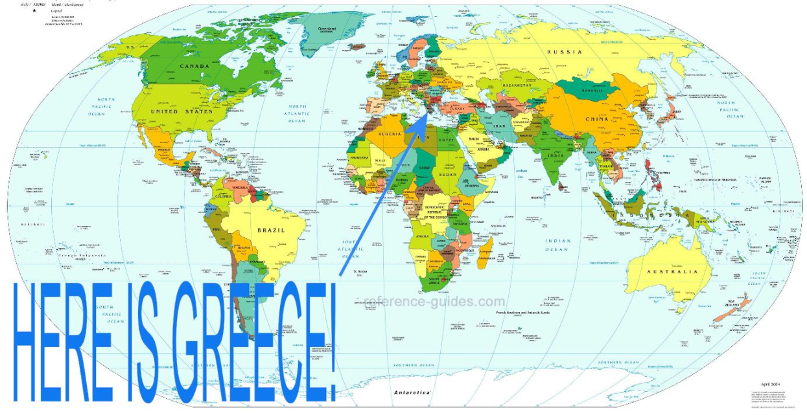
Is Greece located in the Northern Hemisphere or the Southern Hemisphere?
Northern Hemisphere
Southern Hemisphere

Slide 23
Northern Hemisphere

Slide 24

Is Greece located in the Eastern or Western Hemisphere?
Eastern
Western

Slide 25
Eastern Hemisphere

Slide 26
The equator is located to the _______ of Greece.
North
South
East
West

Slide 27
B. South

Slide 28
The Prime Meridian is located to the ______ of Greece.
North
South
East
West

Slide 29
West

Slide 30
Which of the following shows the shape of the country of Greece on a map?
A. B.

Slide 31
A. The other country is Italy. It is located right next to Greece.

Slide 32

Yes or No?
This building has greek influences.

Slide 33
Yes

Slide 34
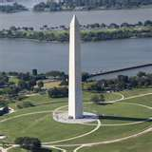
.
Yes or No?
This building has Greek influences.

Slide 35
No

Slide 36
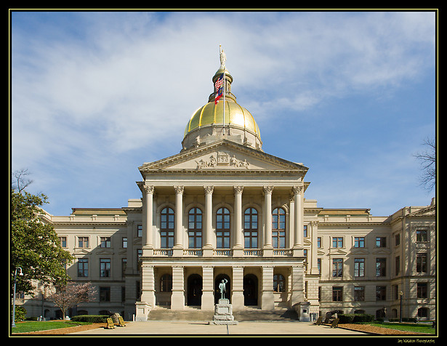
Yes or No?
This building has Greek influences.

Slide 37
Yes

Slide 38
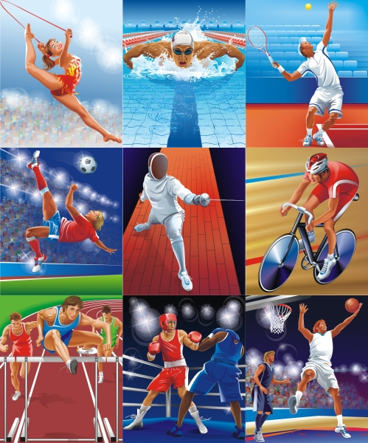
Yes or No?
The scenes shown below are based on a Greek pastime.

Slide 39
Yes

Slide 40
Yes or No?
The building shown has Greek influences.

Slide 41
Yes

Slide 42


True or False?
The word “democracy” describes a government in which the people elect their leaders.

Slide 43
True

Slide 44

True or False?
The Olympic games originated in the country of Italy.

Slide 45
False- They began in Greece

Slide 46

True or False?
Greece is located on the southern coast of Africa.

Slide 47
False- It is located on the southern coast of Europe!

Slide 48

True or False?
The American government is modeled after the democratic government of Greece.

Slide 49
True

Slide 50
True or False?
Many United States buildings modeled Greek architecture by using rounded staircases on the buildings.

Slide 51
False- They used columns!

